Slide 1

NAME
18 OCTOBER 2024
INTRODUCTION TO DATA ANALYTICS
CODE AND CREATE BOOTCAMP

Slide 2

LORRETA ANYIKA
Data Analyst with a background in Computer Science and Statistics.
Founder of ALU Datatok, a student-focused data analytics learning platform.
Experience teaching Excel, SQL, and Python to undergraduates and young professionals.
Passionate about helping enthusiasts transition into data careers
Lorreta Anyika across all socials. Let's connect!

Slide 3
INTRODUCTION TO DATA ANALYTICS
LEARNING OBJECTIVES FOR TODAY
01
02
03
Foundations of Data Analytics
Core Concepts
Introduction to Excel
1. Define Data Analytics and its importance
2. Differentiate between data, information, and insights
1. Types of data
2. Data formats
3. Types of data analytics
4. Data analysis process
1.Why Excel?
2.Overview and Navigation of the Excel interface
3. Simple calculations

Slide 4
INTRODUCTION TO DATA ANALYTICS
FOUNDATIONS OF DATA ANALYTICS
FAQs
What is Data Analytics?
Who is a data analyst?
Is data analysis for me?
Best practices for me to grow?

Slide 5
INTRODUCTION TO DATA ANALYTICS
What is Data Analytics?
The process of collecting, cleaning, and analyzing data to discover patterns and trends.
Importance: Improves efficiency, identifies opportunities & risks, drives innovation and growth
Types of Data Analytics?
Descriptive
Diagnostic
Predictive
Prescriptive
Answers: “What happened?”
Answers: “Why did it happen?”
Answers: “What is likely to happen?”
Answers: “What should we do?”

Slide 6
INTRODUCTION TO DATA ANALYTICS
Who is a data analyst?
A professional who collects, cleans, and interprets data to solve problems.
Uses tools like Excel, SQL, and Python to organize and analyze information.
Transforms raw data into meaningful insights that guide decision-making.
Works across industries such as business, healthcare, finance, education, and technology.
Core responsibilities:
Data cleaning & preparation
Exploratory analysis
Visualization & reporting
Identifying trends, patterns, and opportunities

Slide 7
Is data analysis for me?
INTRODUCTION TO DATA ANALYTICS
Do you enjoy working with numbers, patterns, or problem-solving?
Are you curious about why things happen and eager to find answers in data?
Do you like using technology and tools (Excel, SQL, Python) to make work easier?
Are you comfortable with continuous learning in a fast-evolving field?
Do you want a career with high demand and global opportunities?
Are you passionate about turning raw data into meaningful stories and insights?
✅ If you answered “yes” to most of these, then Data Analytics is a great fit for you!
Understanding your 'why' keeps you going when things get tough

Slide 8
Best practices for me to grow?
INTRODUCTION TO DATA ANALYTICS
You don't need to know all the tools
Understand the basics
Tutorial hell is real. Build projects
Be a master in one tool. It is a transferrable skill

Slide 9
INTRODUCTION TO DATA ANALYTICS
CORE CONCEPTS
Data
Information
Insights
Examples of Data
Numerical Data: Geospatial, time series. others: Exam scores of students, Age, income, or weight, Number of website visitors per day
Textual Data: Social media posts, Customer reviews on Amazon or Google, Emails, News , etc.
Visuals: Medical images (X-rays, MRI scans, CT scans), Photographs and selfies on social media, Security camera footage (CCTV), videos
Audio: Podcasts, recording, voiceovers, .mp3

Slide 10
INTRODUCTION TO DATA ANALYTICS
TYPES OF DATA
Quantitative Data= “How much / How many” (numbers).
E.g Numerical Data
Qualitative Data = “What / Why / How” (descriptions, categories, media).
E.g. : Textual, Visual and Audio data, Categorical Data
A type of qualitative data that represents groups or categories.
Not numerical in value (though sometimes represented with numbers, e.g., 0 = Male, 1 = Female).
Used to classify or label variables without a mathematical meaning.
Types of Categorical Data:
Nominal Data (no order)
Examples: Gender, Marital Status, Blood Group, Country, Hair Color
Ordinal Data (ordered categories)
Examples: Education Level (Primary, Secondary, University)
Customer satisfaction (Poor, Fair, Good, Excellent)
Ranking in a competition (1st, 2nd, 3rd)

Slide 11
INTRODUCTION TO DATA ANALYTICS
TYPES OF DATA
Qualitative Data = “What / Why / How” (descriptions, categories, media).
Examples: Textual, Visual and Audio data, Categorical Data:
A type of qualitative data that represents groups or categories.
Not numerical in value (though sometimes represented with numbers, e.g., 0 = Male, 1 = Female).
Used to classify or label variables without a mathematical meaning.
Types of Categorical Data
Nominal Data (no order)
Examples: Gender, Marital Status, Blood Group, Country, Hair Color
Ordinal Data (ordered categories)
Examples: Education Level (Primary, Secondary, University)
Customer satisfaction (Poor, Fair, Good, Excellent)
Ranking in a competition (1st, 2nd, 3rd)

Slide 12
INTRODUCTION TO DATA ANALYTICS
TYPES OF DATA
Types of Categorical Data
Nominal Data (no order)
Examples: Gender, Marital Status, Blood Group, Country, Hair Color
Ordinal Data (ordered categories)
Examples: Education Level (Primary, Secondary, University)
Customer satisfaction (Poor, Fair, Good, Excellent)
Ranking in a competition (1st, 2nd, 3rd)

Slide 13
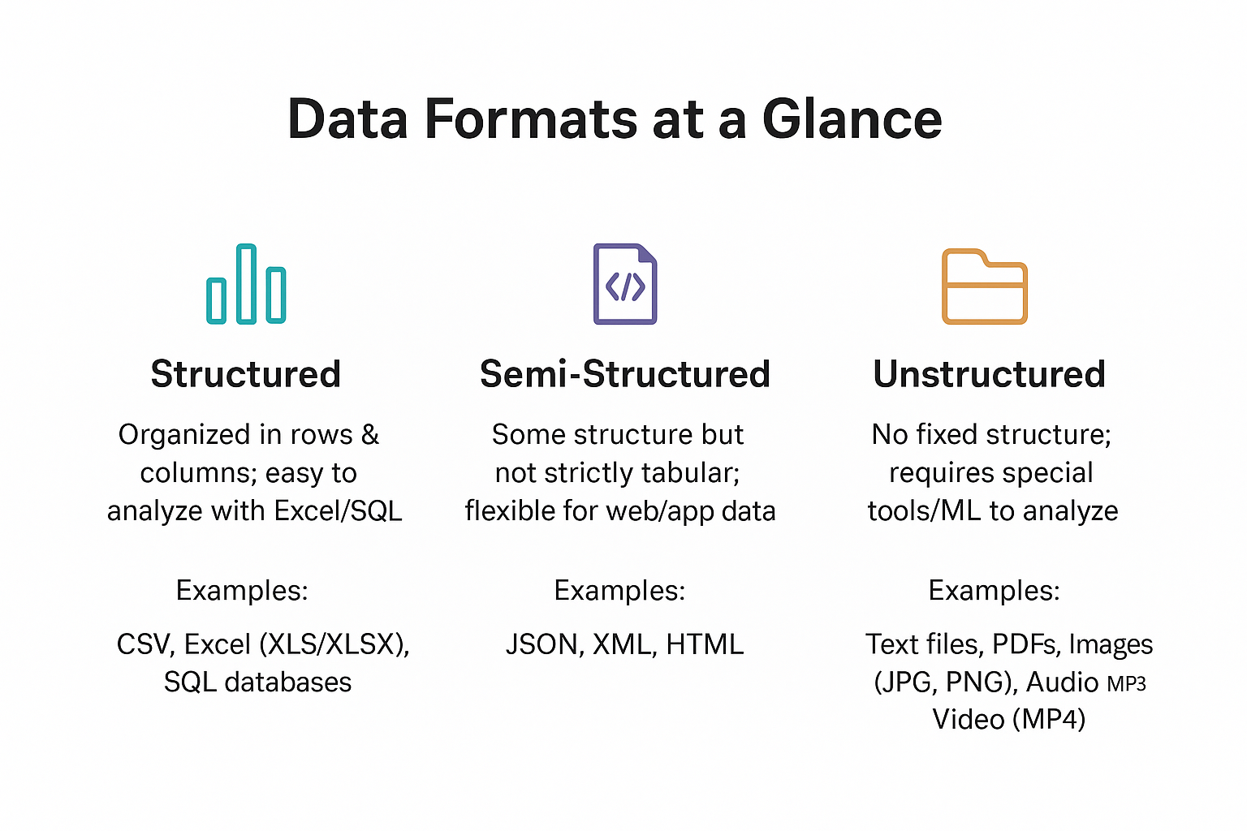
INTRODUCTION TO DATA ANALYTICS
DATA FORMATS
Structured Data : This type of data is organized in rows and columns, making it easy to analyze using tools like Excel or SQL. Common examples include CSV files, Excel workbooks (XLS/XLSX), and SQL databases.
Semi-Structured Data : This has some structure but is not strictly tabular. It is often used in web and application data. Examples include JSON, XML, and HTML, Emails,
Unstructured Data : This data has no fixed structure and usually requires special tools or machine learning to analyze. Examples include text files, PDFs, images (JPG, PNG), audio files (MP3), and videos (MP4).

Slide 14
INTRODUCTION TO DATA ANALYTICS
DATA ANALYSTS AND WORKPLACE
Healthcare – analyzing patient records, disease trends, hospital performance.
Finance & Banking – fraud detection, customer insights, risk analysis.
E-commerce & Retail – customer purchase patterns, inventory management, sales forecasting.
Telecommunications – customer churn analysis, network optimization.
Government & NGOs – population studies, policy impact, program evaluation.
Education – student performance analytics, learning system improvement.
Technology & Startups – product analytics, A/B testing, user behavior insights.
Manufacturing & Supply Chain – process optimization, demand forecasting.Entertainment & Media – audience engagement, content recommendations

Slide 15
INTRODUCTION TO DATA ANALYTICS
KEY SKILLS AND TOOLS FOR DATA ANALYSTS
Spreadsheets
Excel, Google Sheets, Pivot Tables & Functions
Data Visualization
Tableau, Power BI, Excel Charts & Dashboards
Programming
Python (Pandas, NumPy), R (ggplot2, dplyr), Data Wrangling & Automation
Databases
SQL (MySQL, PostgreSQL), Querying & Joins, Handling Large Datasets

Slide 16

INTRODUCTION TO DATA ANALYTICS
SOFT SKILLS
Critical Thinking & Problem-Solving
Communication & Storytelling with Data
Attention to Detail & Accuracy
Business Acumen & Domain Knowledge
Collaboration & Teamwork
Curiosity & Continuous Learning
Presentation skills

Slide 17

INTRODUCTION TO DATA ANALYTICS
INTRODUCTION TO MICROSOFT EXCEL

Slide 18

INTRODUCTION TO DATA ANALYTICS
Q & A

Slide 19



